Slide 1
NFL Quarter Back Analysis 2000- 2015
MICA team:
Mike Jackson, Inder Grang, Chris Conner , Abby Kannappan

Slide 2
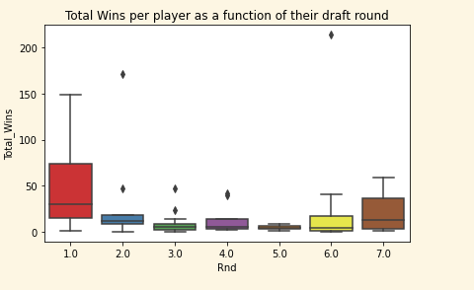
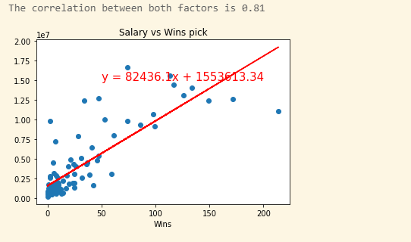
Data Analysis
First round players had the most wins.
Round 3-5 had least wins
Round 6 and 7 surprisingly had more wins.
Here is a linear regression of salary vs number of wins
Correlation coff is 0.81 which means strong correlation
Most of the players got picked at age of 22 or 23

Slide 3
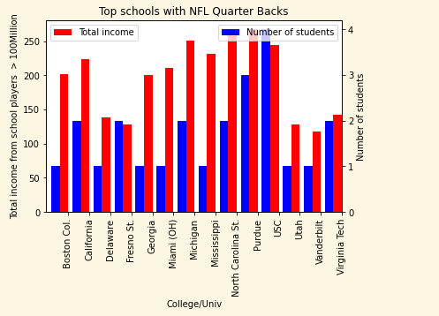
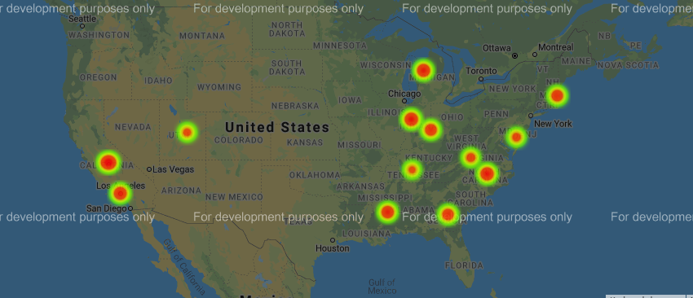
Data Analysis (Colleges/Univ) (Inder)
USC had the most QB players at 4
Most of the schools only had 1 player
Here is a heat plot of geolocations of different univ (weighted by their players’ salaries)

Slide 4
Evaluation of Draft Data (Chris)

Slide 5
Draft Round data vs. NFL performance Stats (Abby)

Slide 6
NFL Performance vs. Salary (Mike)

Slide 7
Data Outliers (Mike)

Slide 8
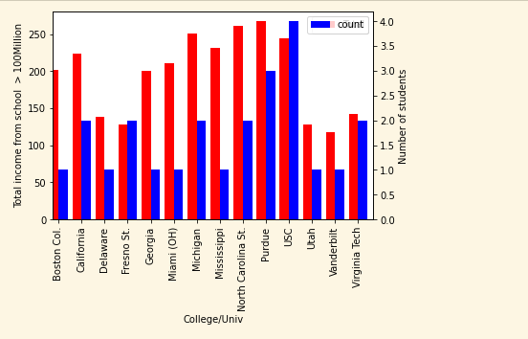
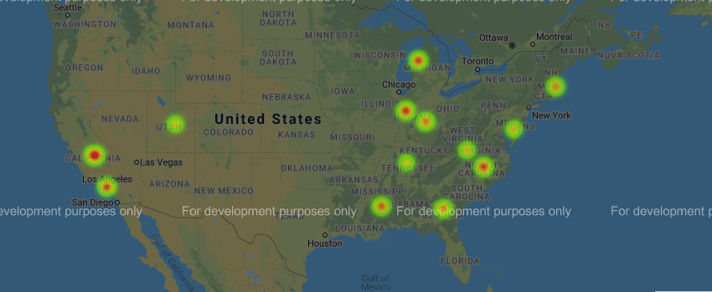
School Statistics and Gmaps
Here is bar graph and heat map of schools that had players generate > 100million along with number of players per school. Top schools are:
USC
Purdue
NC State
Mississippi State?
Univ of Michigan, Ann Arbor
UCLA?

Slide 9
Conclusions (Mike)
Data gathering is non-trivial. Salary information for players needed subscription
Drafting in 3rd, 4th and 5th round is not statistically favorable.
Drafting a QB in the first round provides the most value when you look at $ per win.

